Slide 1
How do I manipulate re-shape data sets?
Business Intelligence Systems and Data Mining IMAT5168 Analytics Programming

Slide 2
SAS provides database access
libname statement
Makes database tables into SAS datasets
Disadvantage: cannot use SQL
proc SQL; … quit;
Provides SQL ‘pass through’
Executes SQL on the database system until quit
connections are made using: connect to
username (user=), password (pwd=)
or dbprompt= to prompt the user for credentials

Slide 3
SAS Libraries
libname name detail
provides a name for a library of data
can be used both for reading & writing
name
e.g. for an OS directory for all types of SAS files
e.g. for a database
detail
"c:\my\path\to\a\SAS\directory" OR
Relational database management system
with username (user=), password (pwd=) & database
NB prefer to use dbprompt= to prompt the user for credentials (otherwise the program contains a plain text password)

Slide 4
Relational Database Primer
Tables
Two dimensional collection of instances of an entity
Columns = attributes
Rows = instances of an entity
Primary key
Each row should have a primary key to identify it
e.g. p-number would identify an instance of Student
Attributes
Data items describing the entity, which are dependant only on the primary key.
The attribute should be expected to change when the table’s primary key changes
Foreign key
Attributes may be used to refer to data in another table by storing a copy of the other table’s primary key
The purpose of linking tables is to avoid duplication of non-primary key data

Slide 5
SQL provides three languages
Structured query language (SQL)
Obtains data from database tables
Data definition language (DDL)
Creates tables in a database
create table / alter table / drop table
Data modification language (DML)
Adds, updates and deletes data in a table
insert / update / delete

Slide 6
Structured Query Language
Select
Attributes
From
A table or joined tables
Where
One or more conditions on one or more attributes is true
Group by
One or more grouping attributes
Having
One or more aggregate conditions is true for a group
Order by
One or more sorting attributes

Slide 7
SQL processing order…
From
Pick the source tables & join them
NB if no join specified, a Cartesian product is created
Where
Selects the rows needed from the (joined) tables
Group by
Groups rows according to one or more variables
Allows calculation of aggregate results e.g. sum, count, average
Having
Selects groups that satisfy a condition on an aggregate result
e.g. having count(variable) > 2
Select
Selects attributes
Name, label, format, calculation
NB distinct/unique may be used to ensure only unique rows
Order by
Sort the attributes into order

Slide 8
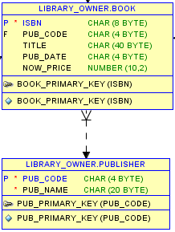
Table Joins
What is a join?
Entity Relationship Diagram
A join allows one table to “look-up” data in another table using a foreign key.
The foreign key is a copy of the look-up table’s primary key (or null).
Example: a library
The BOOK table looks up the publisher’s name in the PUBLISHER table.
When the publisher is unknown, BOOK.PUB_CODE is null
When the foreign key is null:
Use left join to list all rows from BOOK

Slide 9
SQL FROM clause - Venn diagram of sets
KEY: PK = primary key, FK = foreign key, EQ = equals, NE = not equals
PK = a
PK = b, FK = a
Table A
Table B
LEFT JOIN
INNER JOIN
RIGHT JOIN
A.a EQ B.a
AND
A.a NE B.a
A.a EQ B.a
B.a EQ A.a
AND
B.a NE A.a
FULL JOIN
– (A.a EQ B.a) AND (A.a NE B.a) AND (B.a NE A.a)
= all of table A and all of table B

Slide 10
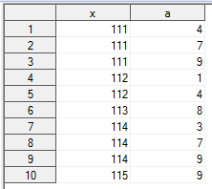
Manipulate rows - Union of select statements
The union statement appends rows
Provided the set of attributes matches
proc sql
select a from A
union
select b from B
union
select c from C;
quit;

Slide 11
Manipulate columns - select/coalesce
proc sql;
create table AB as
select
/* coalesce returns first not null value of its arguments */
coalesce(A.x, B.x) as x /* coalesce is not standard SQL */
, a
, b
from
A
inner join B on B.x = A.x
;
create table TEST4 as /* see next slide for comparison with SAS data step */
select
coalesce(AB.x, C.x) as x
, a
, b
, c
from
C
inner join AB on AB.x = C.x
;
quit;

Slide 12
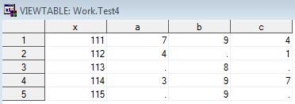
Proof of the pudding…
/* merge using ‘x’ as primary key */
data test2;
merge a b c;
by x;
run;
Obs | x | a | b | c
1 | 111 | 7 | 9 | 4
2 | 112 | 4 | . | 1
3 | 113 | . | 8 | .
4 | 114 | 3 | 9 | 7
5 | 115 | . | 9 | .
Using proc SQL

Slide 13
Manipulate variables - using SAS extensions to SELECT
rename attributes
<attribute> AS <variable>
label attributes
<attribute> LABEL = 'string'
format attributes
<attribute> FORMAT = <format>
perform calculations on attributes
attribute1 / attribute2 * 100 AS percent
NB the calculated value can be used in the where clause: where calculated percent > 25
perform aggregate calculations on attributes
avg(exam) AS average_exam_result (use with group by)
conditionally perform calculations on attributes
case <variable>
[when <condition> then <action>] /* may be repeated */
else <default> end

Slide 14
Repeated measures data sets
Long data
Unit of analysis: the event
Analysis by time
Past behaviour
Forecasts
Comparison of changes over time
Wide data
Unit of analysis: the data subject
Analysis of a series of repeated observations
E.g. average weight after 6 measurements

Slide 15
Repeated Measures: long data
Source data:
Id
Person identifier
Time
Time of measurement
Weight
Weight of person at time of measurement
Obs | id | time | weight
1 | 1 | 1 | 77
2 | 1 | 2 | 79
3 | 1 | 3 | 83
4 | 2 | 1 | 62
5 | 2 | 2 | 58
6 | 2 | 3 | 59
7 | 3 | 1 | 99
8 | 3 | 2 | 97
9 | 3 | 3 | 92

Slide 16
Repeated measures: wide data
Source data:
Id
Person identifier
Weight1
Weight of person at time 1
Weight2
Weight of person at time 2
Weight3
Weight of person at time 3
Obs | id | weight1 | weight2 | weight3
1 | 1 | 77 | 79 | 83
2 | 2 | 62 | 58 | 59
3 | 3 | 99 | 97 | 92

Slide 17
Wide data: array variables
Arrays:
Useful for related observations of the same type about one data subject
e.g. repeated measurements of weight (see slide 16)
Create arrays in the data step using:
The array statement (see slide 18)
Assignment:
to a new or existing array variable
Input statement:
input (v1-v3)
reads 3 numeric variables: v1, v2, v3
NB: the bounds of this array are 1-3

Slide 18
The array statement
array x[*] = x1-x7;
Creates a 7 element array of numbers
array x[7] 5;
Creates a 7 element array of numbers, all with starting value 5
array x[7] a b c d e f g;
Creates a 7 element array of numbers, initialized using variables a to g
NB when SAS compiles the data step, the number of elements must be known
Access:
first element: x[1] or x1 or a
last element: x[7] or x7 or g
3rd element: x[3] or x3 or c
_temporary_ creates a temporary array that is not written to the output data set (see: Language Reference Concepts – p587)
_numeric_ and _character_ allow you to initialize the array with all numeric or all character variables in the data step (see: Language Reference Concepts – p581).

Slide 19
Array functions
Given:
array x[7] a b c d e f g;
dim(x) = 7
Determine the size of the array
of
Use the entire array as input to a function
sumx = sum(of x)
in
Search for a value in an array
if 5 in x then ...
vname()
Find the variable initializing an element
'd' = vname(4)

Slide 20
Repetition statements allow you to manipulate each element of an array…
Test on loop entry
Test on loop exit
initialize;
do while (condition);
action;
increment;
end;
k = 1;
do while (k < 10);
put k;
k = k + 2;
end;
initialize;
do until (condition);
action;
increment;
end;
j = 1;
do until (j >= 10);
put j;
j = j + 2;
end;

Slide 21
Safe repetition…
Counted repetition avoids infinite loops by setting a limit on the number of repetitions.
General format:
do
i = start * i = index variable ;
to finish
by increment;
action1;
action2;
…
actionn;
end;

Slide 22
Re-shaping data
When:
Data have been entered as events
AND
You want to analyse repeated observations together…
Transform to wide format using proc transform
Removing the event identifying variable (usually time)
When:
Data have been entered in an array
AND
you want to analyse by event
Transform to long format using the output command
Adding an event identifying variable (e.g. event number)

Slide 23
Transposing long to wide
proc transpose
data = long
out = wide
(drop = _name_)
prefix = weight
/* weight# */ ;
by id;
var weight;
id time;
run;
Allows calculation of
summary measures of weight
Obs | id | weight1 | weight2 | weight3
1 | 1 | 77 | 79 | 83
2 | 2 | 62 | 58 | 59
3 | 3 | 99 | 97 | 92

Slide 24
Transposing wide to long
data time_data;
input
name $
sex $
t1-t6 ; * input an array ;
array times{*} t1-t6; * declare the array ;
do index = 1 to dim(times); * dim() sets upper limit index ;
time = index; * set time to index value ;
score = times{index}; * set score using index^{th} time ;
output; * output the data set so far ;
end;
keep name sex time score; * keep the desired variables;
datalines;
Smith M 6 6 5 5 5 4 3
Jones F 7 5 4 4 3 2 1
Fisher M 5 5 5 3 2 2 1
;
run;

Slide 25
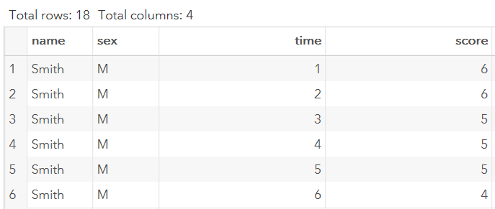
Transposing wide to long: result
Name and sex remain the same and a new variable ‘time’ is associated with each score.
The scores previously in a row are now in a column.

